Slide 1
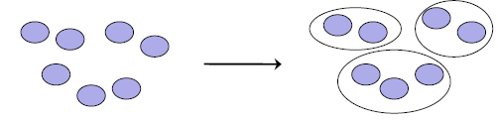
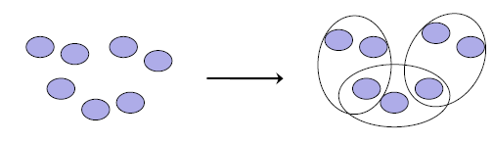
Introduction to Cluster
Hard clustering:
Each document belongs to exactly one cluster.
More common and easier to do
Soft clustering:
A document can belong to more than one cluster.
Makes more sense for applications like creating browsable hierarchies
You may want to put sneakers in two clusters:
sports apparel
shoes
Notes:
First, let's define NER!
go through pages, recognize the names of things: "Bill MacCartney", "Stanford University"
the people who came up with this task had a rather precise, philosophically motivated meaning in mind
entity: a discrete, actual thing: Bill MacCartney, but not calcium carbonate or Tuesday or Viagra
named entity: an entity with a name, in a philosophical, Kripke-like sense
(this water bottle is an entity, but not a NAMED entity)
but in practice the definition has been expanded quite a bit in later work
we routinely include dates & times, proteins, drug names
but still, loosely, things that have a name
but NOT references to entities which are not names: "this university", "it”
first task in NER: identifying occurrences of named entities
looking for capital letters is a really good clue! at least in English! but not so much in Hebrew, Chinese, ... non-Latinate alphabets also doesn't really work in German -- all nouns are capitalized!
so that's a pretty useful base-level task -- widely deployed and used
you've probably seen web pages that do this
e.g. financial web sites often mark up stock symbols, names of companies
Microsoft has done work with this, smart tags, entities tagged with metadata
Reuters has web service OpenCalais, you send them docs, they send back NER markup
1

Slide 2
Flat Algorithms
Flat algorithms compute a partition of N-documents into a set of K-clusters
Given:
A set of documents and the number-K
Find:
A partition into K-clusters that optimizes the chosen partitioning criterion
Global optimization:
exhaustively enumerate partitions, pick optimal one
Not tractable
Effective heuristic method:
K-means algorithm
Notes:
First, let's define NER!
go through pages, recognize the names of things: "Bill MacCartney", "Stanford University"
the people who came up with this task had a rather precise, philosophically motivated meaning in mind
entity: a discrete, actual thing: Bill MacCartney, but not calcium carbonate or Tuesday or Viagra
named entity: an entity with a name, in a philosophical, Kripke-like sense
(this water bottle is an entity, but not a NAMED entity)
but in practice the definition has been expanded quite a bit in later work
we routinely include dates & times, proteins, drug names
but still, loosely, things that have a name
but NOT references to entities which are not names: "this university", "it”
first task in NER: identifying occurrences of named entities
looking for capital letters is a really good clue! at least in English! but not so much in Hebrew, Chinese, ... non-Latinate alphabets also doesn't really work in German -- all nouns are capitalized!
so that's a pretty useful base-level task -- widely deployed and used
you've probably seen web pages that do this
e.g. financial web sites often mark up stock symbols, names of companies
Microsoft has done work with this, smart tags, entities tagged with metadata
Reuters has web service OpenCalais, you send them docs, they send back NER markup
2

Slide 3
K-means Algorithm
Perhaps the best known clustering algorithm
Simple, works well in many cases
Use as default / baseline for clustering documents
Notes:
First, let's define NER!
go through pages, recognize the names of things: "Bill MacCartney", "Stanford University"
the people who came up with this task had a rather precise, philosophically motivated meaning in mind
entity: a discrete, actual thing: Bill MacCartney, but not calcium carbonate or Tuesday or Viagra
named entity: an entity with a name, in a philosophical, Kripke-like sense
(this water bottle is an entity, but not a NAMED entity)
but in practice the definition has been expanded quite a bit in later work
we routinely include dates & times, proteins, drug names
but still, loosely, things that have a name
but NOT references to entities which are not names: "this university", "it”
first task in NER: identifying occurrences of named entities
looking for capital letters is a really good clue! at least in English! but not so much in Hebrew, Chinese, ... non-Latinate alphabets also doesn't really work in German -- all nouns are capitalized!
so that's a pretty useful base-level task -- widely deployed and used
you've probably seen web pages that do this
e.g. financial web sites often mark up stock symbols, names of companies
Microsoft has done work with this, smart tags, entities tagged with metadata
Reuters has web service OpenCalais, you send them docs, they send back NER markup
3

Slide 4

K-means Algorithm
Each cluster in K-means is defined by a centroid.
Objective/partitioning criterion:
minimize the average squared difference from the centroid
Recall definition of centroid:
where we use ω to denote a cluster.
We try to find the minimum average squared difference by iterating two steps:
reassignment: assign each vector to its closest centroid
recomputation: precompute each centroid as the average of the vectors that were assigned to it in reassignment
Notes:
First, let's define NER!
go through pages, recognize the names of things: "Bill MacCartney", "Stanford University"
the people who came up with this task had a rather precise, philosophically motivated meaning in mind
entity: a discrete, actual thing: Bill MacCartney, but not calcium carbonate or Tuesday or Viagra
named entity: an entity with a name, in a philosophical, Kripke-like sense
(this water bottle is an entity, but not a NAMED entity)
but in practice the definition has been expanded quite a bit in later work
we routinely include dates & times, proteins, drug names
but still, loosely, things that have a name
but NOT references to entities which are not names: "this university", "it”
first task in NER: identifying occurrences of named entities
looking for capital letters is a really good clue! at least in English! but not so much in Hebrew, Chinese, ... non-Latinate alphabets also doesn't really work in German -- all nouns are capitalized!
so that's a pretty useful base-level task -- widely deployed and used
you've probably seen web pages that do this
e.g. financial web sites often mark up stock symbols, names of companies
Microsoft has done work with this, smart tags, entities tagged with metadata
Reuters has web service OpenCalais, you send them docs, they send back NER markup
4

Slide 5
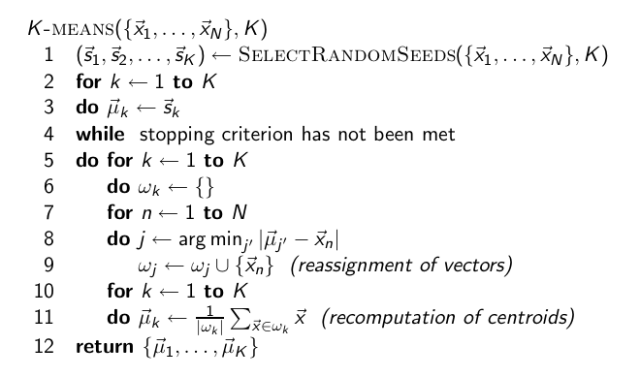
K-means Algorithm
Notes:
First, let's define NER!
go through pages, recognize the names of things: "Bill MacCartney", "Stanford University"
the people who came up with this task had a rather precise, philosophically motivated meaning in mind
entity: a discrete, actual thing: Bill MacCartney, but not calcium carbonate or Tuesday or Viagra
named entity: an entity with a name, in a philosophical, Kripke-like sense
(this water bottle is an entity, but not a NAMED entity)
but in practice the definition has been expanded quite a bit in later work
we routinely include dates & times, proteins, drug names
but still, loosely, things that have a name
but NOT references to entities which are not names: "this university", "it”
first task in NER: identifying occurrences of named entities
looking for capital letters is a really good clue! at least in English! but not so much in Hebrew, Chinese, ... non-Latinate alphabets also doesn't really work in German -- all nouns are capitalized!
so that's a pretty useful base-level task -- widely deployed and used
you've probably seen web pages that do this
e.g. financial web sites often mark up stock symbols, names of companies
Microsoft has done work with this, smart tags, entities tagged with metadata
Reuters has web service OpenCalais, you send them docs, they send back NER markup
5

Slide 6
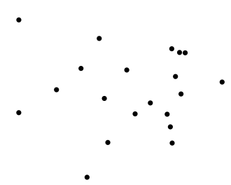
Worked Example: Set of to be clustered
6
Notes:
6

Slide 7
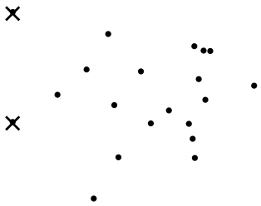
Worked Example: Random selection of initial
centroids
Exercise: (i) Guess what the
optimal clustering into two clusters is in this case; (ii) compute the
centroids of the clusters
7
7
Notes:
7

Slide 8
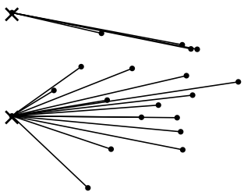
Worked Example: Assign points to closest center
8
Notes:
8

Slide 9
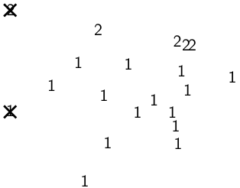
Worked Example: Assignment
9
Notes:
9

Slide 10
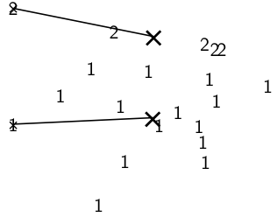
Worked Example: Recompute cluster centroids
10
Notes:
10

Slide 11
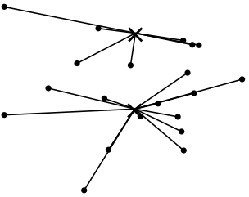
Worked Example: Assign points to closest centroid
11
Notes:
11

Slide 12
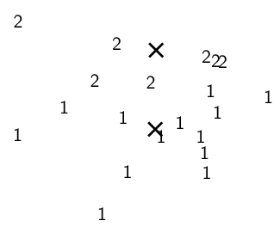
Worked Example: Assignment
12
Notes:
12

Slide 13
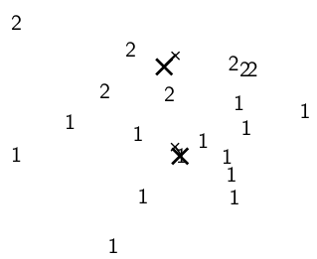
Worked Example: Recompute cluster centroids
13
Notes:
13

Slide 14
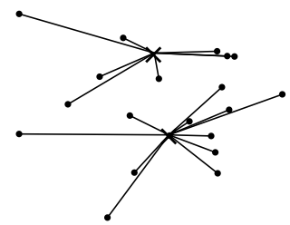
Worked Example: Assign points to closest centroid
14
Notes:
14

Slide 15
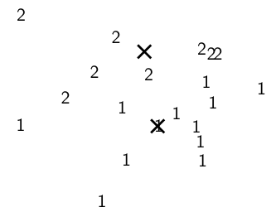
Worked Example: Assignment
15
Notes:
15

Slide 16
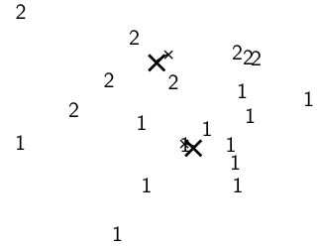
Worked Example: Recompute cluster centroids
16
Notes:
16

Slide 17
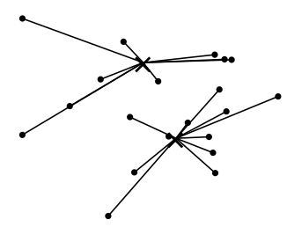
Worked Example: Assign points to closest centroid
17
Notes:
17

Slide 18
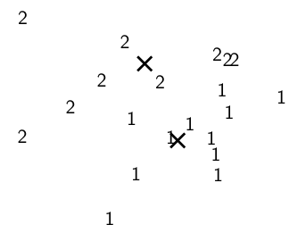
Worked Example: Assignment
18
Notes:
18

Slide 19
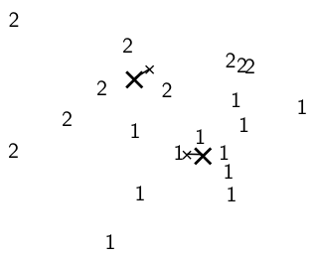
Worked Example: Recompute cluster centroids
19
Notes:
19

Slide 20
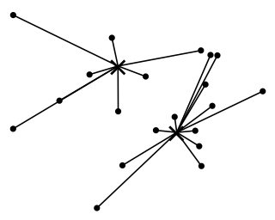
Worked Example: Assign points to closest centroid
20
Notes:
20

Slide 21
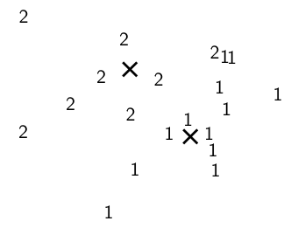
Worked Example: Assignment
21
Notes:
21

Slide 22
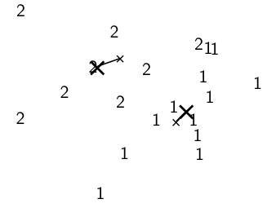
Worked Example: Recompute cluster centroids
22
Notes:
22

Slide 23
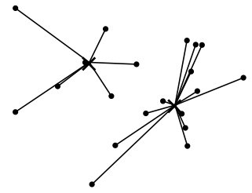
Worked Example: Assign points to closest centroid
23
Notes:
23

Slide 24
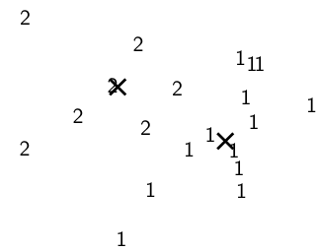
Worked Example: Assignment
24
Notes:
24

Slide 25
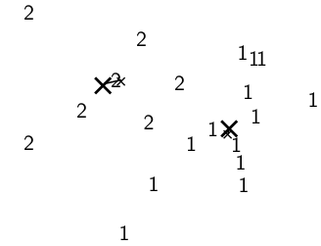
Worked Example: Recompute cluster centroids
25
Notes:
25

Slide 26
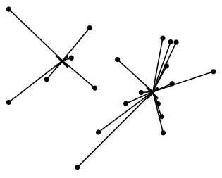
Worked Example: Assign points to closest centroid
26
Notes:
26

Slide 27
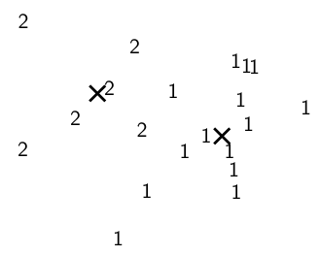
Worked Example: Assignment
27
Notes:
27

Slide 28
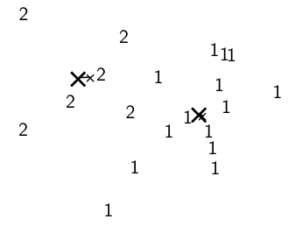
Worked Example: Recompute cluster caentroids
28
Notes:
28

Slide 29
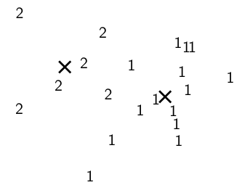
Worked Ex.: Centroids and assignments after convergence
29
Notes:
29

Slide 30
K-Means Algorithm
Initialization of K-Means:
Random seed selection is just one of many ways K-means can be initialized
Random seed selection is not very robust: It’s easy to get a suboptimal clustering.
Better ways of computing initial centroids:
Select seeds not randomly, but using some heuristic (e.g., filter out outliers or find a set of seeds that has “good coverage” of the document space)
Use hierarchical clustering to find good seeds
Select i (e.g., i = 10) different random sets of seeds, do a K-means clustering for each, select the clustering with lowest RSS
Notes:
First, let's define NER!
go through pages, recognize the names of things: "Bill MacCartney", "Stanford University"
the people who came up with this task had a rather precise, philosophically motivated meaning in mind
entity: a discrete, actual thing: Bill MacCartney, but not calcium carbonate or Tuesday or Viagra
named entity: an entity with a name, in a philosophical, Kripke-like sense
(this water bottle is an entity, but not a NAMED entity)
but in practice the definition has been expanded quite a bit in later work
we routinely include dates & times, proteins, drug names
but still, loosely, things that have a name
but NOT references to entities which are not names: "this university", "it”
first task in NER: identifying occurrences of named entities
looking for capital letters is a really good clue! at least in English! but not so much in Hebrew, Chinese, ... non-Latinate alphabets also doesn't really work in German -- all nouns are capitalized!
so that's a pretty useful base-level task -- widely deployed and used
you've probably seen web pages that do this
e.g. financial web sites often mark up stock symbols, names of companies
Microsoft has done work with this, smart tags, entities tagged with metadata
Reuters has web service OpenCalais, you send them docs, they send back NER markup
30

Slide 31
K-Means Algorithm
Termination conditions:
A fixed number of iterations has been applied.
This condition limits the runtime of the clustering algorithm.
Poor quality of clustering with an insufficient number of iterations.
Assignment of documents to clusters does not change between iterations.
Except for cases for bad local minima, it produce good clustering but runtime may be unacceptably long.
Centroid do not change between iterations.
this is equivalent to not change in partition function
Terminate when RSS(residual sum of squares) falls below threshold.
It ensures that the clustering is of a desired quality after termination.
In practice we need to combine it with a bound on the number of iterations to guarantee termination.
Notes:
First, let's define NER!
go through pages, recognize the names of things: "Bill MacCartney", "Stanford University"
the people who came up with this task had a rather precise, philosophically motivated meaning in mind
entity: a discrete, actual thing: Bill MacCartney, but not calcium carbonate or Tuesday or Viagra
named entity: an entity with a name, in a philosophical, Kripke-like sense
(this water bottle is an entity, but not a NAMED entity)
but in practice the definition has been expanded quite a bit in later work
we routinely include dates & times, proteins, drug names
but still, loosely, things that have a name
but NOT references to entities which are not names: "this university", "it”
first task in NER: identifying occurrences of named entities
looking for capital letters is a really good clue! at least in English! but not so much in Hebrew, Chinese, ... non-Latinate alphabets also doesn't really work in German -- all nouns are capitalized!
so that's a pretty useful base-level task -- widely deployed and used
you've probably seen web pages that do this
e.g. financial web sites often mark up stock symbols, names of companies
Microsoft has done work with this, smart tags, entities tagged with metadata
Reuters has web service OpenCalais, you send them docs, they send back NER markup
31

Slide 32
K-Means Algorithm
Time Complexity:
Computing one distance of two vectors is O(M).
Reassignment step: O(KNM) (we need to compute KN document-centroid distances)
Recomputation step: O(NM) (we need to add each of the document’s < M values to one of the centroids)
Assume number of iterations bounded by I
Overall complexity: O(IKNM) – linear in all important dimensions
However: This is not a real worst-case analysis.
In pathological cases, complexity can be worse than linear.
Notes:
First, let's define NER!
go through pages, recognize the names of things: "Bill MacCartney", "Stanford University"
the people who came up with this task had a rather precise, philosophically motivated meaning in mind
entity: a discrete, actual thing: Bill MacCartney, but not calcium carbonate or Tuesday or Viagra
named entity: an entity with a name, in a philosophical, Kripke-like sense
(this water bottle is an entity, but not a NAMED entity)
but in practice the definition has been expanded quite a bit in later work
we routinely include dates & times, proteins, drug names
but still, loosely, things that have a name
but NOT references to entities which are not names: "this university", "it”
first task in NER: identifying occurrences of named entities
looking for capital letters is a really good clue! at least in English! but not so much in Hebrew, Chinese, ... non-Latinate alphabets also doesn't really work in German -- all nouns are capitalized!
so that's a pretty useful base-level task -- widely deployed and used
you've probably seen web pages that do this
e.g. financial web sites often mark up stock symbols, names of companies
Microsoft has done work with this, smart tags, entities tagged with metadata
Reuters has web service OpenCalais, you send them docs, they send back NER markup
32

Slide 33
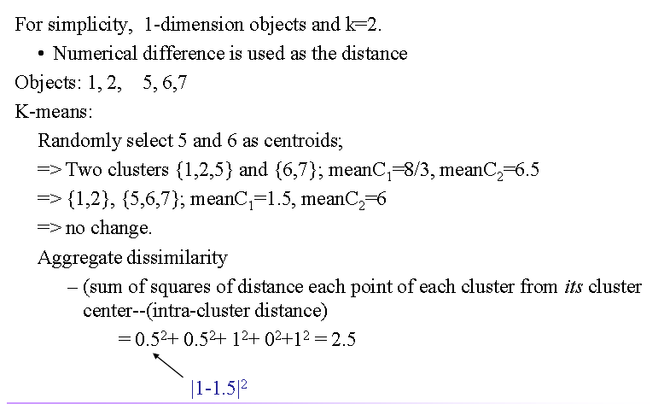
K-Means Example
Notes:
First, let's define NER!
go through pages, recognize the names of things: "Bill MacCartney", "Stanford University"
the people who came up with this task had a rather precise, philosophically motivated meaning in mind
entity: a discrete, actual thing: Bill MacCartney, but not calcium carbonate or Tuesday or Viagra
named entity: an entity with a name, in a philosophical, Kripke-like sense
(this water bottle is an entity, but not a NAMED entity)
but in practice the definition has been expanded quite a bit in later work
we routinely include dates & times, proteins, drug names
but still, loosely, things that have a name
but NOT references to entities which are not names: "this university", "it”
first task in NER: identifying occurrences of named entities
looking for capital letters is a really good clue! at least in English! but not so much in Hebrew, Chinese, ... non-Latinate alphabets also doesn't really work in German -- all nouns are capitalized!
so that's a pretty useful base-level task -- widely deployed and used
you've probably seen web pages that do this
e.g. financial web sites often mark up stock symbols, names of companies
Microsoft has done work with this, smart tags, entities tagged with metadata
Reuters has web service OpenCalais, you send them docs, they send back NER markup
33

Slide 34
Sec. 16.4
K Means Example (K=2)
Pick seeds
Reassign clusters
Compute centroids
Reassign clusters
x
x
x
Compute centroids
x
x
x
Reassign clusters
Converged!

Slide 35
Ch. 17
Hierarchical Clustering
Build a tree-based hierarchical taxonomy (dendrogram) from a set of documents.
One approach: recursive application of a partitional clustering algorithm.
animal
vertebrate
invertebrate
fish reptile amphib. mammal worm insect crustacean

Slide 36
Dendrogram: Hierarchical Clustering
Clustering obtained by cutting the dendrogram at a desired level: each connected component forms a cluster.
36

Slide 37
Sec. 17.1
Hierarchical Agglomerative Clustering (HAC)
Starts with each doc in a separate cluster
then repeatedly joins the closest pair of clusters, until there is only one cluster.
The history of merging forms a binary tree or hierarchy.
Note: the resulting clusters are still “hard” and induce a partition

Slide 38
Sec. 17.2
Closest pair of clusters
Many variants to defining closest pair of clusters
Single-link
Similarity of the most cosine-similar (single-link)
Complete-link
Similarity of the “furthest” points, the least cosine-similar
Centroid
Clusters whose centroids (centers of gravity) are the most cosine-similar
Average-link
Average cosine between all pairs of elements

Slide 39
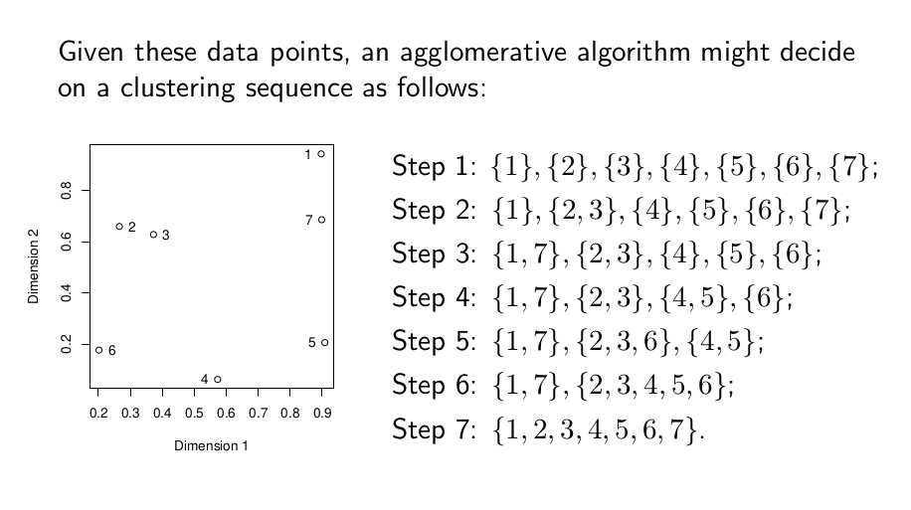
Sec. 17.2
Simple Example

Slide 40
Sec. 17.2
Single Link Agglomerative Clustering
Use maximum similarity of pairs:
Can result in “straggly” (long and thin) clusters due to chaining effect.
After merging c_{i} and c_{j}, the similarity of the resulting cluster to another cluster, c_{k}, is:

Slide 41
Sec. 17.2
Single Link Example

Slide 42
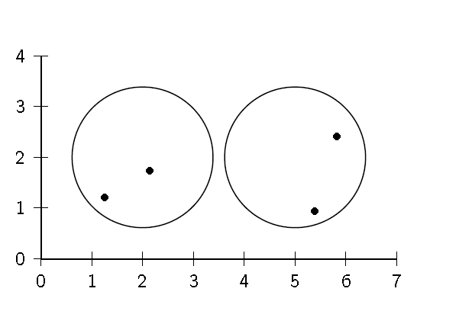
Sec. 17.2
Clustering Similarity: Example

Slide 43
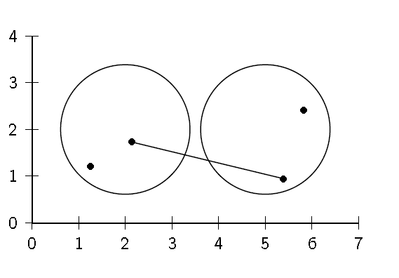
Sec. 17.2
Single Link : Maximum Similarity

Slide 44
Single-link clustering: example
5
1
3
5
2
1
2
3
6
4
4
Nested Clusters
Dendrogram
Notes:
44

Slide 45
Sec. 17.2
Complete Link
Use minimum similarity of pairs:
Makes “tighter,” spherical clusters that are typically preferable.
After merging c_{i} and c_{j}, the similarity of the resulting cluster to another cluster, c_{k}, is:
C_{i}
C_{j}
C_{k}

Slide 46
Sec. 17.2
Complete Link Example

Slide 47
Sec. 17.2
Clustering Similarity: Example

Slide 48
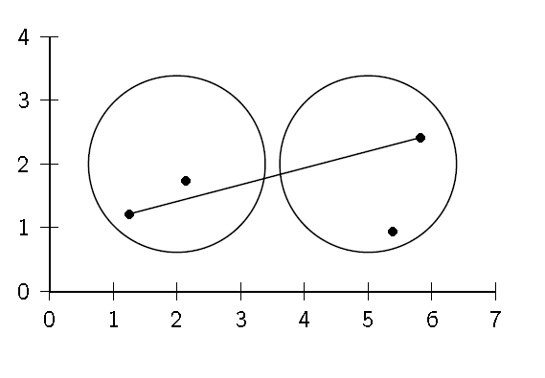
Sec. 17.2
Complete Link: Minimum Similarity

Slide 49
Sec. 17.2
Centroid Average Similarity: Example
intersimilarity = similarity of two documents in different clusters

Slide 50
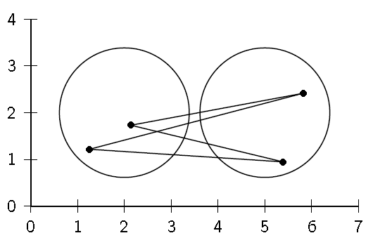
Sec. 17.2
Centroid Average Similarity: Example
intersimilarity = similarity of two documents in different clusters

Slide 51
Sec. 17.3
Group Average
Similarity of two clusters = average similarity of all pairs within merged cluster.
Compromise between single and complete link.
Two options:
Averaged across all ordered pairs in the merged cluster
Averaged over all pairs between the two original clusters
No clear difference in efficacy

Slide 52
Sec. 17.2
Group Average : Average Intrasimilarity
intrasimilarity = similarity of any pair, including cases where the two documents are in the same cluster

Slide 53
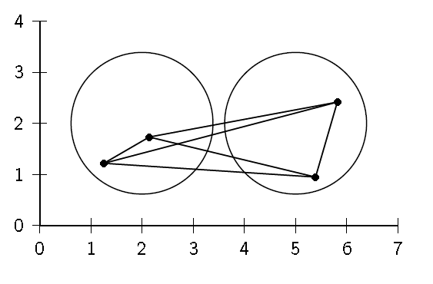
Sec. 17.2
Group Average : Average Intrasimilarity
intrasimilarity = similarity of any pair, including cases where the two documents are in the same cluster

Slide 54
Sec. 17.3
Computing Group Average Similarity
Always maintain sum of vectors in each cluster.
Compute similarity of clusters in constant time:

Slide 55
Sec. 16.3
What Is A Good Clustering?
Internal criterion: A good clustering will produce high quality clusters in which:
the intra-class (that is, intra-cluster) similarity is high
the inter-class similarity is low
The measured quality of a clustering depends on both the document representation and the similarity measure used

